Slide 1
SIGN LANGUAGE DETECTION AND TRANSLATION BY IMAGE PROCESSING
SRIRAM T
2020504587

Slide 2
ACKNOWLEDGEMENTS
We consider it as our privilege and our primary duty to express our gratitude and respect to all those who guided and inspired us in the successful completion of the project.
We owe solemn gratitude to Dr. J. PRAKASH, Dean, Madras Institute of Technology, for having given consent to carry out the project work at MIT Campus, Anna University.
We wish to express our sincere appreciation and gratitude to Dr. INDUMATHI, Professor and Head of the Department of Electronics Engineering, who has encouraged and motivated us in our endeavours.
We are extremely grateful to our project guide Dr.M.MANIKANDAN for their timely and thoughtful guidance and encouragement for the completion of the project. We also thank all the teaching and non-teaching staff members of the Department of Electronics Engineering for their support in all aspects.

Slide 3
WHAT IS IMAGE PROCESSING?
Image processing is the process Of transforming an image into a digital form and performing certain operations to get some useful information from it.
there are certain PROCESSES involved in image processing such as :
Image acquisition
Image enhancement
IMAGE RESTORATION
IMAGE SEGMENTATION
IMAGE COMPRESSION
IMAGE RECOGNITION

Slide 4
INTRODUCTION
This project helps us to detect or identify sign language and efficiently translate it in realtime using pycharm which is a dedicated Python Integrated Development Environment (IDE)
providing a wide range of essential tools for Python developers, tightly integrated to create a convenient environment for productive Python, web and data science development. The purpose of sign language recognition systems is to provide an efficient and accurate way to convert sign language into text or voice. Recent field of research is intended to focus on effectively recognizing signs under computing power constraints.
Although sign language is the most natural way of exchanging information among deaf people it has been observed that they are facing difficulties with normal people interaction. Sign language consists of vocabulary of signs in exactly the same way as spoken language consists of a vocabulary of words. Sign languages are not standard and universal and the grammars
differ from country to country .In this project we are using American Sign Language for detection and translation.

Slide 5
OBJECTIVE
The main objective of the project is to demonstrate Detection and Translation of Sign language in real time using pycharm which is a Python Integrated Development Environment (IDE).

Slide 6
METHODOLOGY
At first a basic study was done on sign language and we chose alphabets of American sign language as the samples for the detection and translation.
For the samples for the detection and translation a python source code named DATACOLLECTION is used to capture multiple samples of the alphabets of sign language using a webcam.
The collected samples are then used create a machine learning model.
Teachable machine is web based tool used to convert the collected samples to a machine learning model.
This model is then specified in another python source code named DETECTION AND TRANSLATION which is used in detection and translation of the alphabets of American sign language.

Slide 7
SOFTWARE USED
PYCHARM:
Pycharm is a dedicated Python Integrated Development Environment (IDE) providing a wide range of essential tools for Python developers, tightly integrated to create a convenient environment for productive Python, web and data science development.

Slide 8
PYCHARM IS AVAILABLE IN THREE EDITIONS
Community: For Python development including code assistance, refactorings, visual debugging and versioncontrol integration. It is free and open sourced.
Professional: For professional Python, web and data science development, including code assistance,refactorings, visual debugging and version control
integration, remote configurations, deployment, support for
popular web frameworks. It is paid to use.
Edu: For learning programming languages and related technologies with integrated educational tools.

Slide 9
LIBRARIES USED:
CVZONE:-
•This is a Computer vision package that makes its easy to run Image processing
2. MEDIAPIPE:-
• THIS is a cross-platform library developed by Google that is widely used for image analysis, image processing, detection, recognition, etc.

Slide 10
FLOW CHART:
CAPTURE THE HAND SIGNS USING A PYthON CODE
THESE IMAGES ARE CAPTURED IN 300X300 JPEG FORMAT
THESE IMAGES ARE THEN CONVERTED TO A MACHINE MODEL
TRANSLATION OF THE given SIGN gesture IS FOUND
THIS MODEL IS SPECIFIED IN THE PYTHON CODE TO IDENTIFY THE HAND GESTURE AND PROVIDE ITS EQUIVALENT TRANSLATION
IN REAL TIME
THIS MACHINE MODEL IS USED FOR IMAGE RECOGNITION

Slide 11
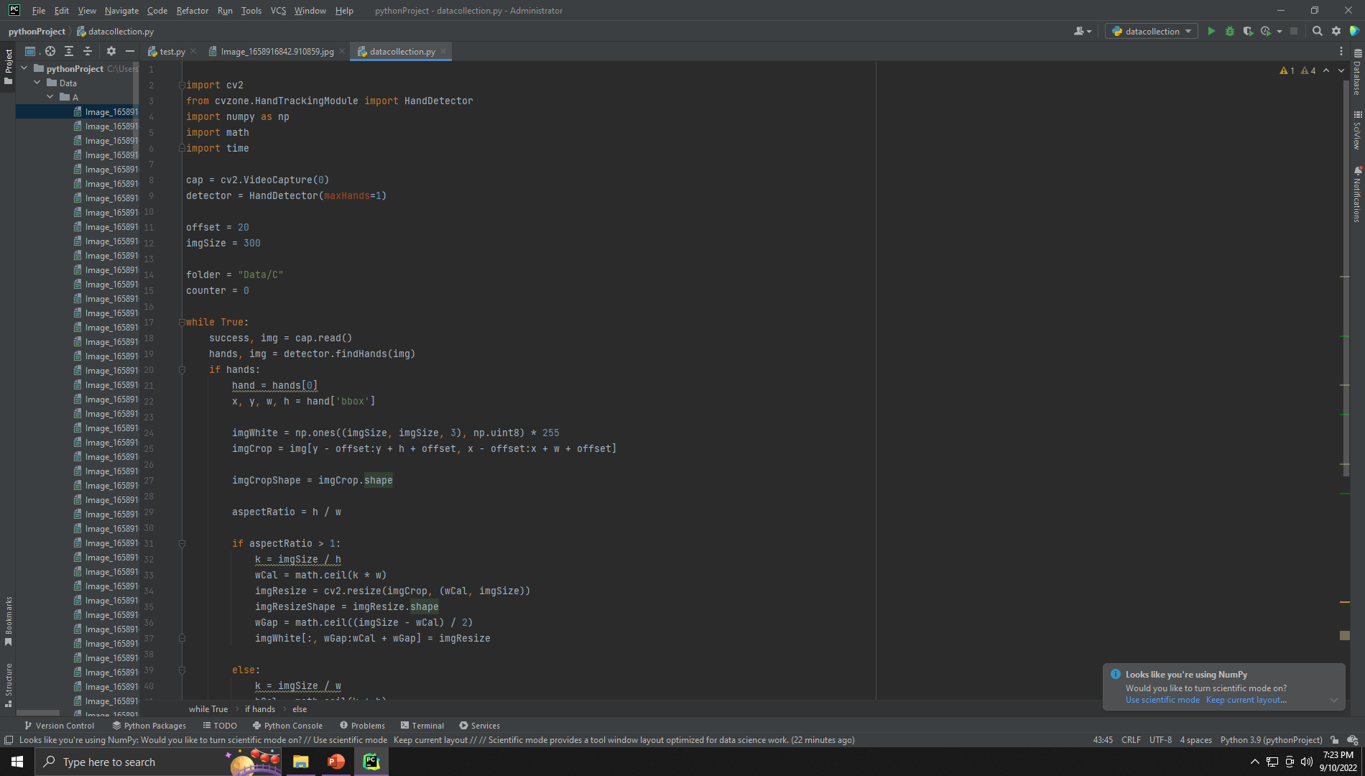
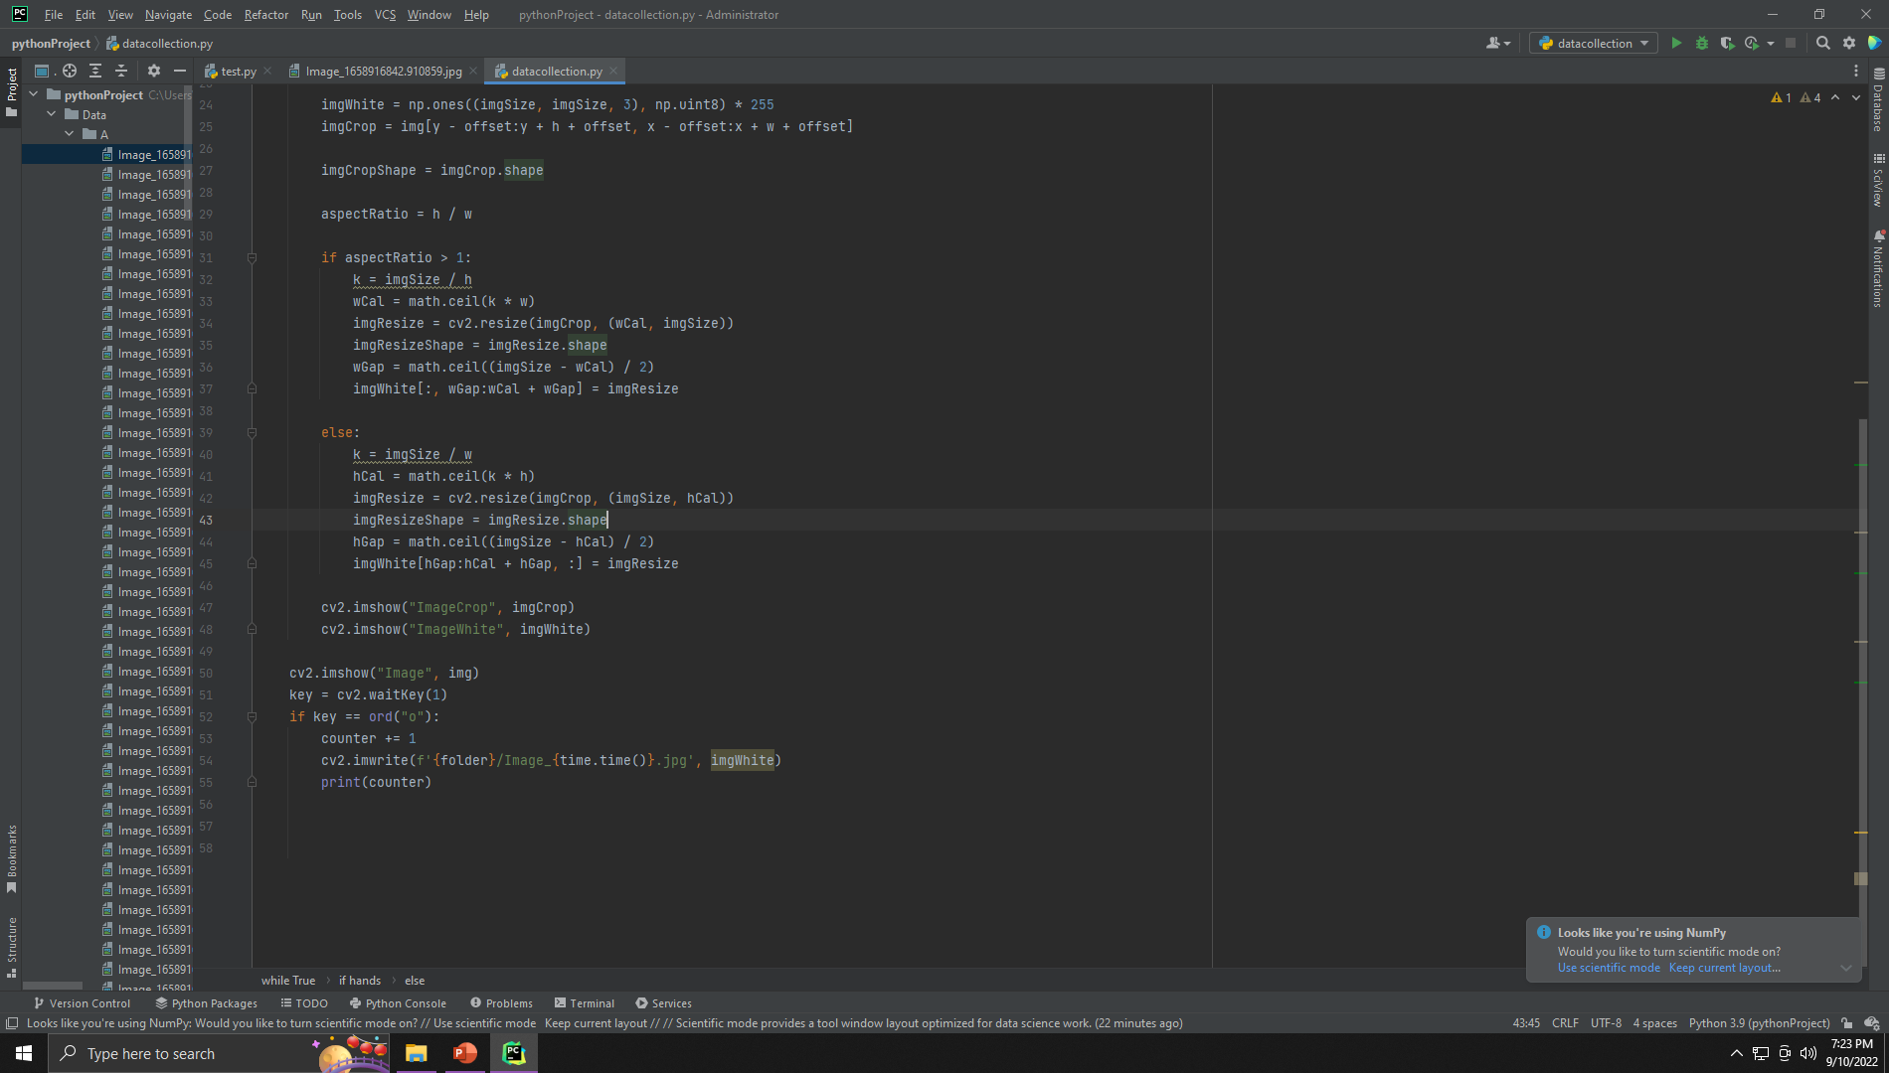
PYTHON CODE FOR DATA COLLECTION:

Slide 12
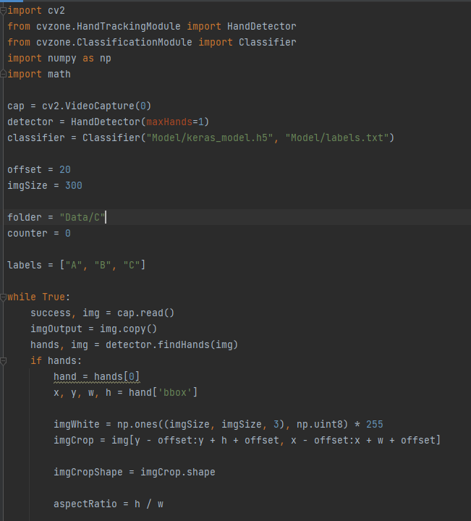
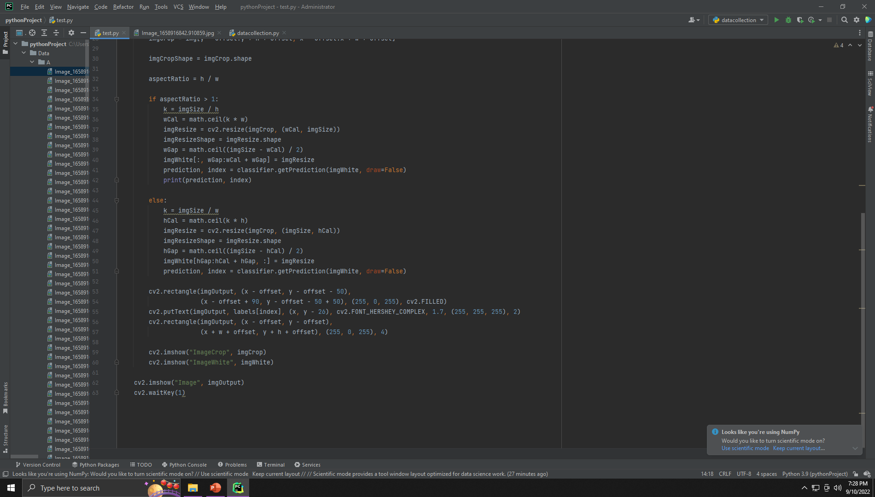
PYTHON CODE FOR EXECUTION:

Slide 13
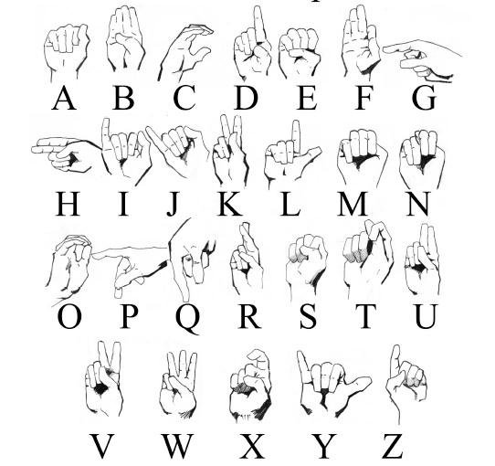
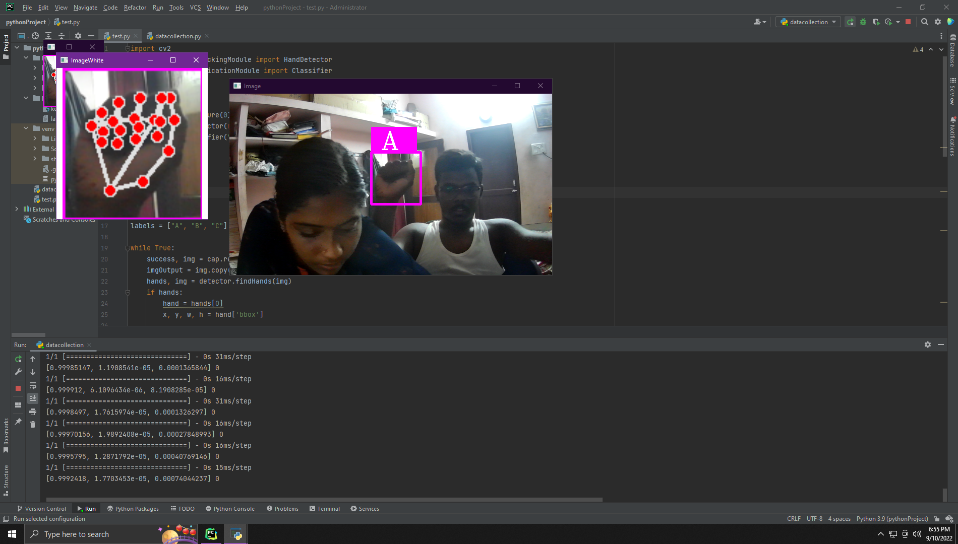
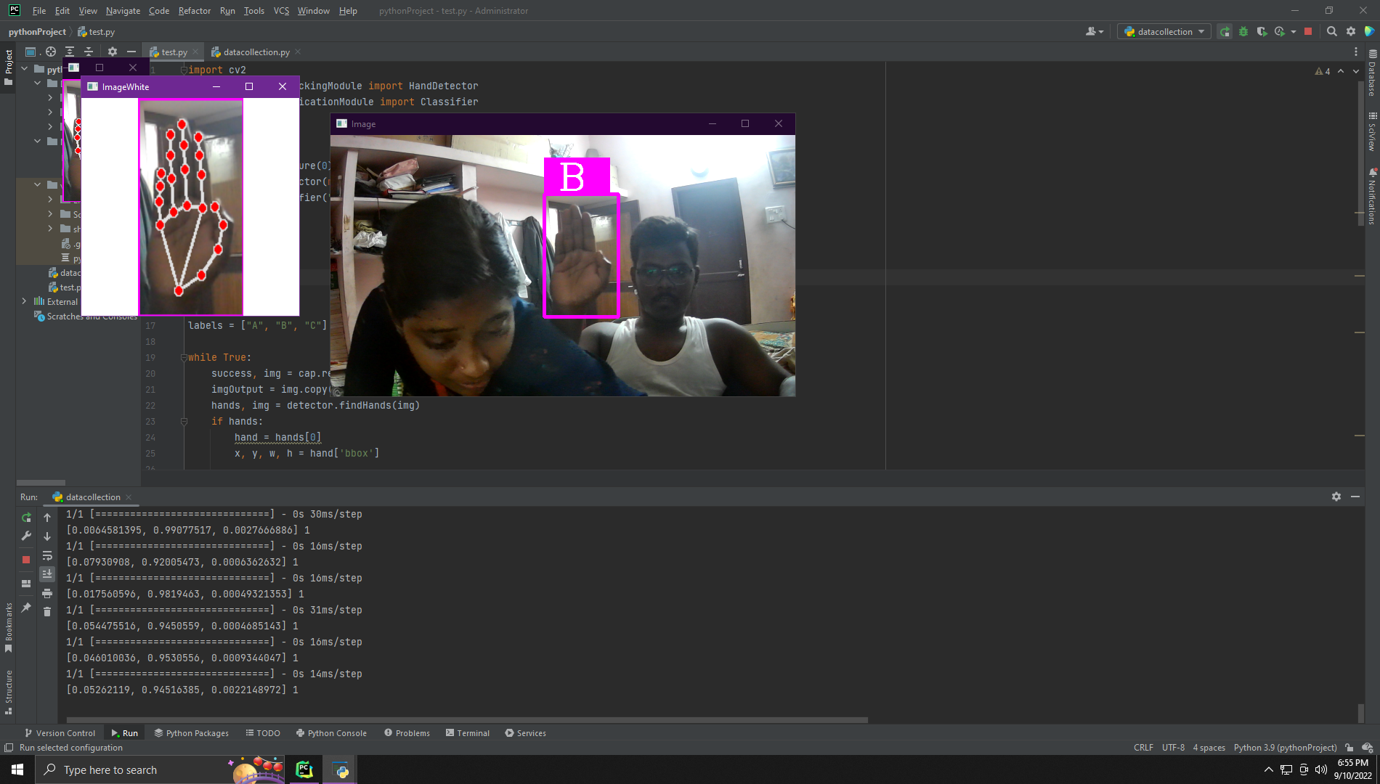
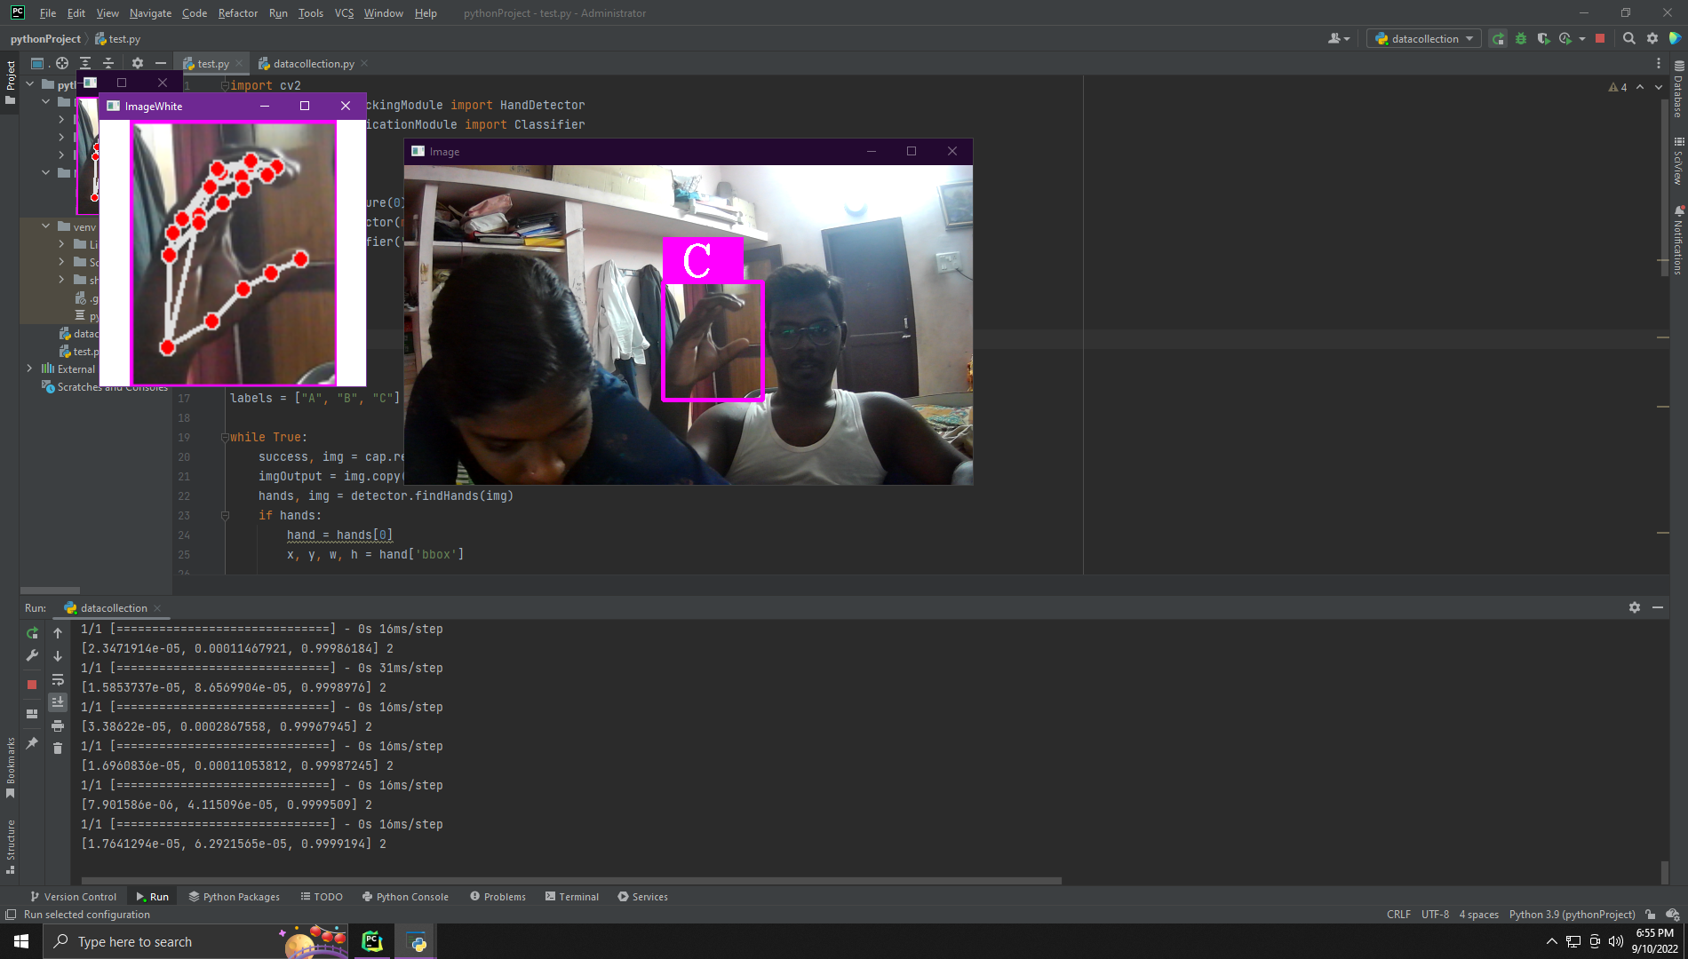
OUTPUT:

Slide 14
CONCLUSION
The code for sign language detection and translation is successfully executed in pycharm using cvzone and mediapipe
libraries.

Slide 15
REFERENCES
https://core.ac.uk/download/pdf/55638597.pdf
https://data-flair.training/blogs/sign-language-
recognition-python-ml-opencv/#:~:text=In%20this%20sign%20language%20recognition,and%20Keras%20modules%20of%20python.
https://www.analyticsvidhya.com/blog/2021/06/sign-
language-recognition-for-computer-vision-enthusiasts/
https://www.youtube.com/watch?v=wa2ARoUUdU8

Slide 16
THANK YOU

